Slide 1
QUIZ - 1
What is the type of the following: 0
Int
Float
What is the type of the following number: 3.12323
Int
Float
What is the result of the following: int(3.99)
3
3.99
4

Slide 2
QUIZ - 2
What is the result of the following operation: 11//2
???
5.5
5
What is the value of x after the following is run: x=4 x=x/2
???
4.0
2.0

Slide 3
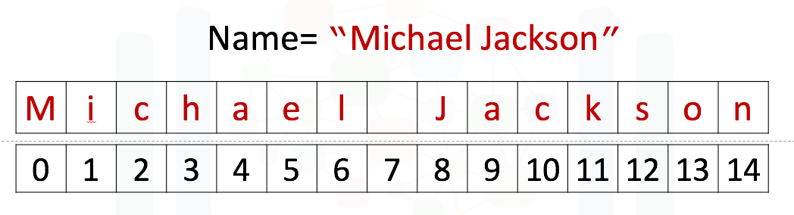
QUIZ - 3
What is the result of the following: Name[1]?
M
n
I
What is the result of the following: Name[-1]?
M
n
O
What is the result of following: "hello Mike".find("Mike")?
1
6
7
6,7,8,9
What is the output of the following: print("AB\nC\nDE")?
AB C DE
ABC DE
AB CD E

Slide 4
JUPYTER
A “Notebook” is a work book in which mixes text with coding for Python.
Online server: https://colab.research.google.com
Specific for our lesson notebook:
https://colab.research.google.com/github/urishani/KFAR-VRADIM/blob/main/EXPRESSIONS%20AND%20VARIABLES.ipynb
Github: urishani/KFAR-VRADIM
Link: https://github.com/urishani/KFAR-VRADIM.git

Slide 5
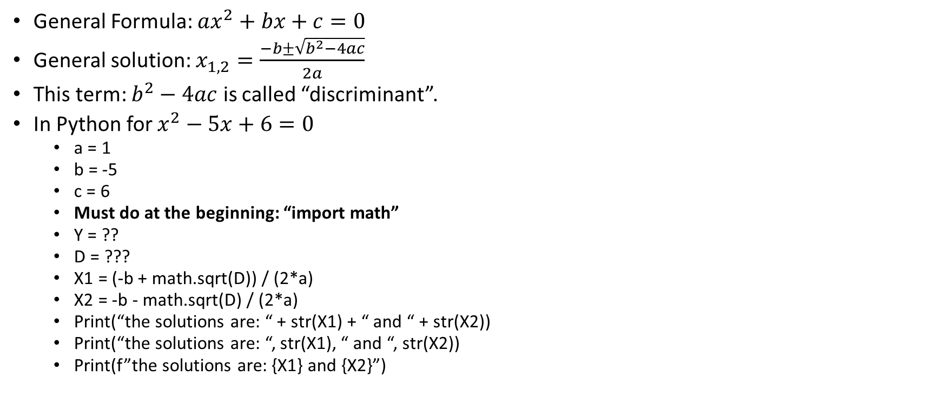
משוואה ריבועית
General Formula: $ax^{2}+bx+c=0$
General solution: $x_{1,2}=\frac{−b±\sqrt{b^{2}−4ac}}{2a}$
This term: $b^{2}−4ac$ is called “discriminant”.
In Python for $x^{2}−5x+6=0$
a = 1
b = -5
c = 6
Must do at the beginning: “import math”
Y = ??
D = ???
X1 = (-b + math.sqrt(D)) / (2*a)
X2 = -b - math.sqrt(D) / (2*a)
Print(“the solutions are: “ + str(X1) + “ and “ + str(X2))
Print(“the solutions are: “, str(X1), “ and “, str(X2))
Print(f”the solutions are: {X1} and {X2}”)

Slide 6
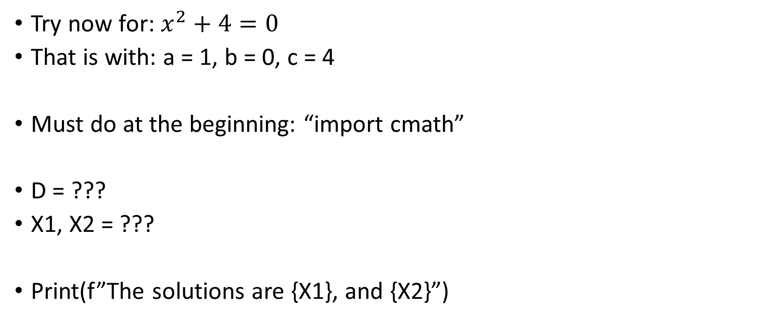
משוואה ריבועית - 2
Try now for: $x^{2}+4=0$
That is with: a = 1, b = 0, c = 4
Must do at the beginning: “import cmath”
D = ???
X1, X2 = ???
Print(f”The solutions are {X1}, and {X2}”)

